Slide 1
Department of Computer Science and Engineering
Securing Digital Payments with Iris Scanning using Blockchain Technology
Under the Guidance of
Dr.G.Sreeram
Professor,Dept of CSE
Batch No:-9
Divyanshi Roy - 21P61A0562
B.Tanya - 21P61A0535
B. Snigdha - 21P61A0536

Slide 2
CONTENTS
Abstract
Introduction
Literature Survey
Problem statement
Objectives
Software and Hardware requirements
Proposed Methodology
Modules
Implementation
Results
References

Slide 3
Abstract
Iris Pay transforms digital payments by leveraging blockchain technology to enhance security, transparency, and efficiency. The platform aims to reduce fraud and operational costs by eliminating intermediaries, integrating seamlessly with existing financial systems. Through smart contracts, it automates payment processes to ensure timely and reliable transactions. Iris Pay also addresses scalability challenges and employs advanced cryptographic techniques to protect user data, setting a new benchmark for secure and efficient digital payments.

Slide 4
Introduction
Iris Pay combines biometric authentication (iris scanning) with blockchain technology to deliver unparalleled security, privacy, and efficiency in online transactions, ensuring only authorized users can complete transactions .
The integration of blockchain technology further enhances this platform by offering a decentralized and immutable ledger, guaranteeing transparency and security throughout the transaction process.
Iris Pay redefines online payment security, offering a seamless, user-friendly experience that sets a new standard for digital payments.

Slide 5
Literature Survey
Research Area | Study/Reference | Pros | Cons
Iris Authentication in Payments | John Daugman (2004), “How Iris Recognition Works” | High accuracy, non-invasive, fast identification. | Requires specialized hardware (iris scanners), increased cost.
Block chain in Digital Payments | Satoshi Nakamoto (2008), “Bitcoin: A Peer-to-Peer Electronic Cash System” | Decentralization enhances security, prevents fraud. | High energy consumption, slower transactions compared to traditional systems.
Combining Iris Authentication with Blockchain | Zheng Zhang et al. (2020), “Blockchain-Based Iris Biometric Authentication System” | Strong biometric security paired with decentralized control, no central authority. | Complex and resource-intensive integration. Slower verification if not optimized.
Iris Authentication for Mobile Payments | Sanchez et al. (2017), “Mobile Biometric Payment System Using Iris Authentication” | Convenient for users, enhances security by combining mobile and biometric factors. | Limited adoption due to hardware requirements, risk of spoofing without anti-spoofing measures.
Cont..

Slide 6
Research Area | Study/Reference | Pros | Cons
Security using Blockchain | Andoni et al. (2019), “Blockchain Technology in the Energy Sector” | Ensures data integrity and prevents tampering with transaction records. | Scalability issues due to the large size of the Blockchain
Privacy in Blockchain Transactions | Narayanan et al. (2016), “Bitcoin and Cryptocurrency Technologies” | Blockchain transactions are encrypted, offering protection from unauthorized access. | Blockchain is transparent, and transaction metadata can sometimes reveal identities if not properly anonymized.
Blockchain for Micropayments | MicroRaiden (2017), “Blockchain Micropayments Channel for Scalable, Instant Transactions” | Allows low-cost, fast micropayments with minimal transaction fees. | Micropayment channels can become congested under high transaction volumes, affecting efficiency.
Iris Data Storage and Encryption | Agrafioti et al. (2011), “Secure Biometric Systems: A Case Study in Iris Template Protection” | Use of advanced encryption techniques to securely store and transfer iris biometric data. | Heavy encryption techniques can lead to slower processing times during authentication.

Slide 7
Problem Statement
Current digital payment systems primarily rely on PINs or fingerprint biometrics for authentication, but these methods can be vulnerable to security breaches and fraud.
Iris Pay seeks to address this gap by introducing iris scanning as a robust authentication method, leveraging blockchain technology to ensure secure, fraud-resistant transactions and enhance overall payment security.

Slide 8
Objectives
Iris Pay leverages blockchain technology to provide a secure and transparent digital payment platform, effectively preventing fraud and reducing transaction costs.
The platform offers a reliable, decentralized solution for digital payments, ensuring greater integrity and trust in financial transactions.

Slide 9
System Requirements
Hardware Requirements :
Processor: Intel i3 or higher, or equivalent
RAM: Minimum 8 GB
Storage: Minimum 256 GB SSD
Camera: High-resolution camera (at least 1080p).
Software Requirements:
Operating System: Microsoft Windows 10/11
IDE: Visual Studio Code
Programming Languages :Python (v3.x),Solidity ,JavaScript ,HTML /CSS
Libraries and Frameworks :OpenCV ,Web3.py ,Flask
Blockchain Framework:Ganache ,Truffle , Ethereum.
Package Managers and Other Tools:NPM (Node Package Manager) ,Chocolatey ,JSON files

Slide 10
Proposed Methodology
Design and Integration:
Develop a secure architecture combining iris scanning and blockchain for transactions.
Choose technologies for accurate iris scanning and reliable blockchain integration.
Development and Testing:
Build and integrate frontend and backend components with smart contracts.
Test functionality, performance, and security thoroughly.
Deployment and Maintenance:
Deploy the system to a production environment.
Monitor, support, and continuously improve based on feedback and performance data.

Slide 11
Modules
User Enrollment and Iris Scanning Module:- Handles user registration and biometric data collection.
Capture and store iris scan data securely.
Perform initial identity verification and associate biometric data with the user's profile.
Blockchain Integration Module:- Connects the application to the blockchain network.
Register each user as a unique identity on the blockchain.
Manage secure data storage on blockchain for user transactions and profiles.
Technology used is Ethereum (or similar), smart contracts, blockchain API.

Slide 12
Smart Contracts Module:- payment processes are done using blockchain smart contracts.
Execute payments and verify identity through iris scanning.
Ensure predefined conditions (e.g., successful verification) are met before payment is authorized.
Technology: Solidity (for Ethereum), blockchain development environment Ganache.
Transaction Processing Module:- Manages transaction requests and confirms payments.
Validates user identity and proceeds with the transaction using iris scan
Process payment transactions, verify data authenticity, and ensure data integrity.
Send notifications to users of successful and failed transactions.

Slide 13
Implementation
Frontend Development:
Completed Web Pages: User dashboard, registration, login, transaction history , transaction pages and iris scanning interfaces.
Backend Development:
Server-Side Functionalities: User authentication, transaction processing, and data encryption implemented.
Database Integration: User profiles, transaction logs, and blockchain data storage.
Blockchain Connection: Smart contracts deployed and integrated with the backend for automated payments.

Slide 14
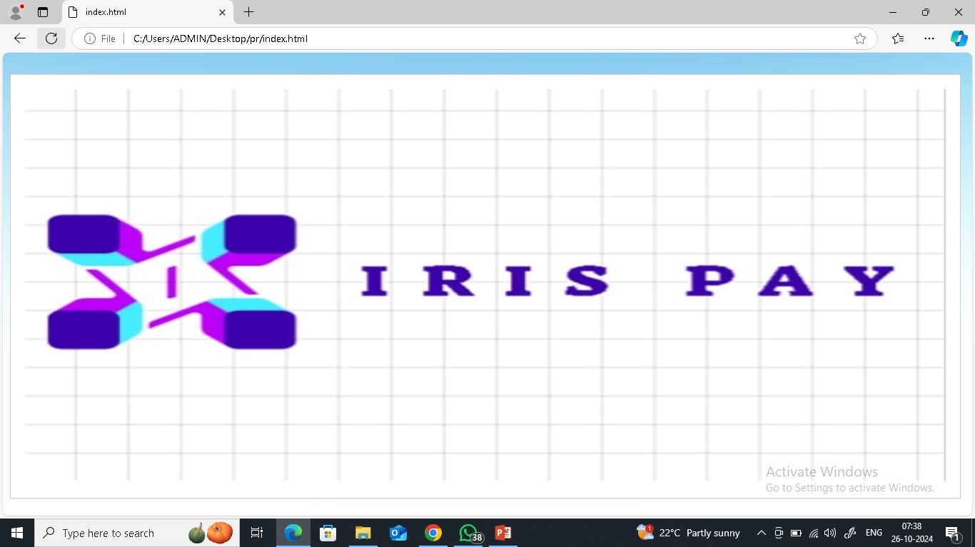

Slide 15
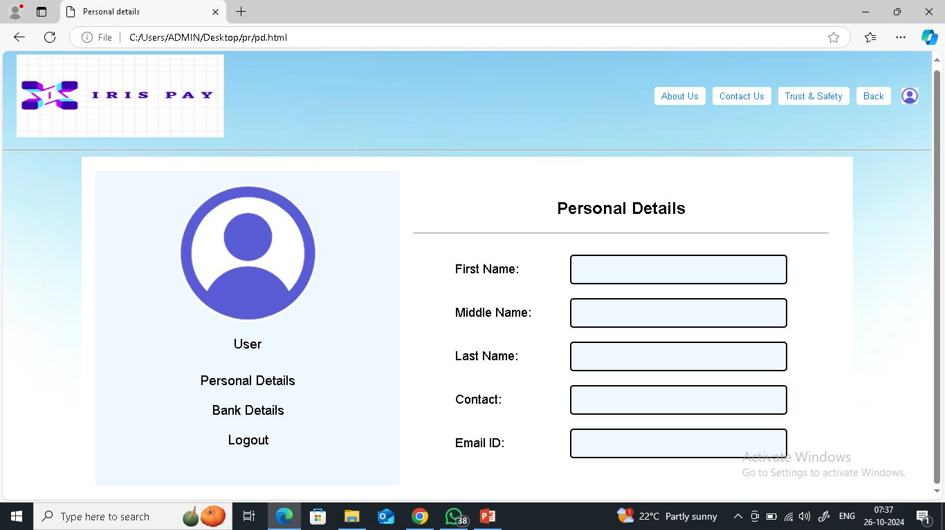

Slide 16
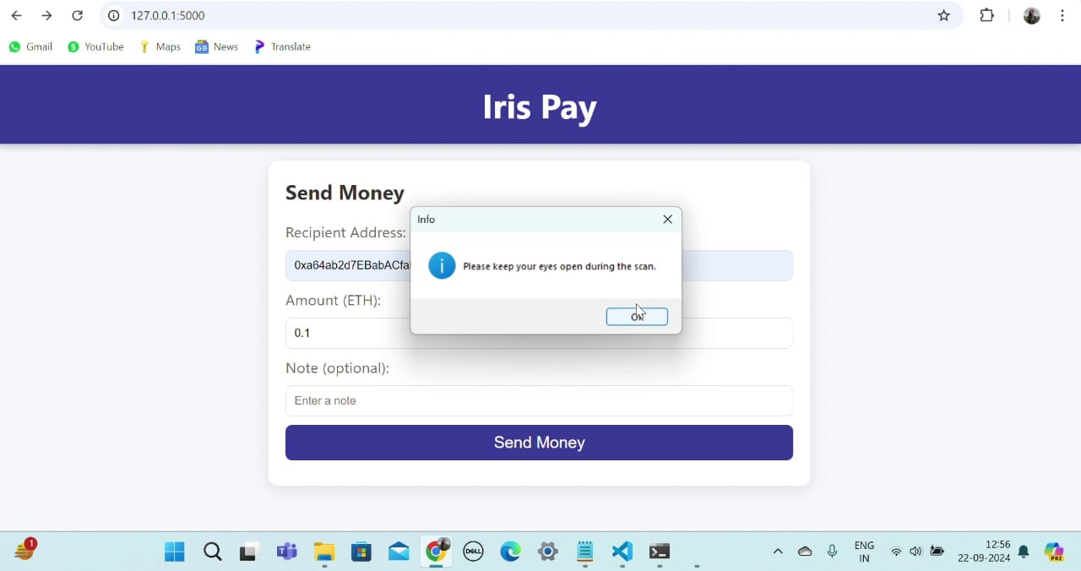

Slide 17
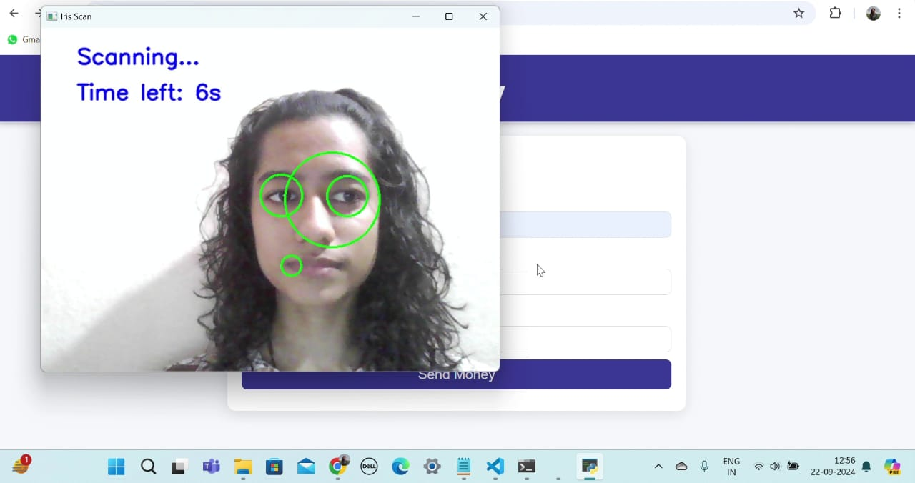

Slide 18
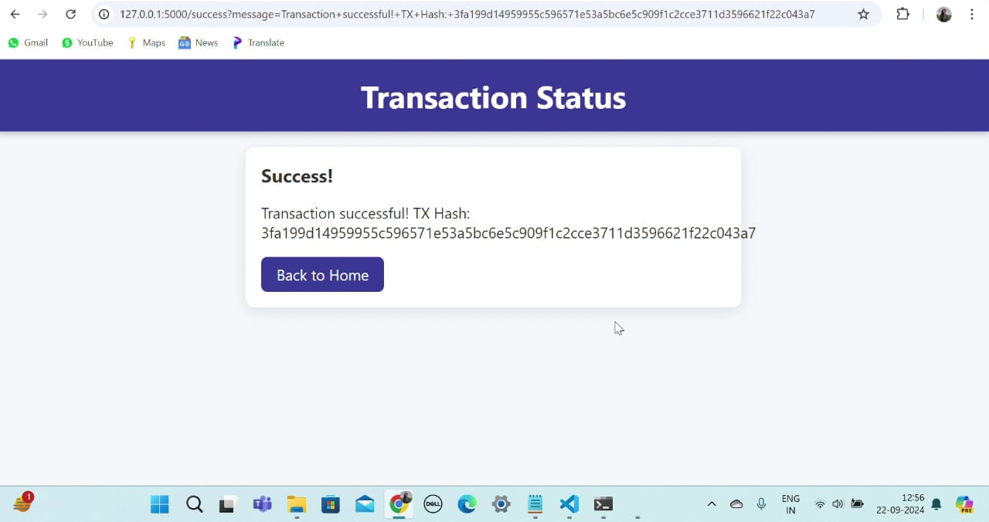

Slide 19
References
W3C Decentralized Identifiers (2021), “DID: Digital Identity for Secure Payments”.
Polkadot Whitepaper (2020), “Enabling Blockchain Interoperability for Payments”.
Zheng Zhang et al. (2020), “Blockchain-Based Iris Biometric Authentication System”.
Andoni et al. (2019), “Blockchain Technology in the Energy Sector”.
Sanchez et al. (2017), “Mobile Biometric Payment System Using Iris Authentication”.
MicroRaiden (2017), “Blockchain Micropayments Channels for Scalable, Instant Transactions”.
Narayanan et al. (2016), “Bitcoin and Cryptocurrency Technologies”.

Slide 20
Agrafioti et al. (2011), “Secure Biometric Systems: A Case Study in Iris Template Protection”.
Satoshi Nakamoto (2008), “Bitcoin: A Peer-to-Peer Electronic Cash System”.
John Daugman (2004), “How Iris Recognition Works”.

Slide 21
THANK YOU

